Slide 1
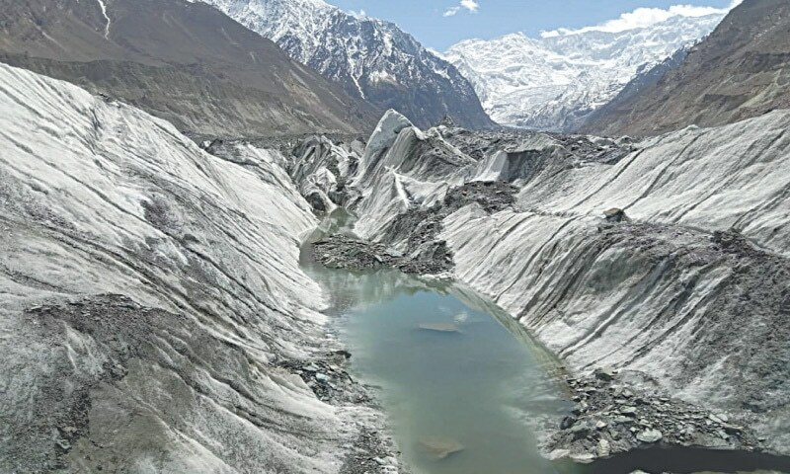
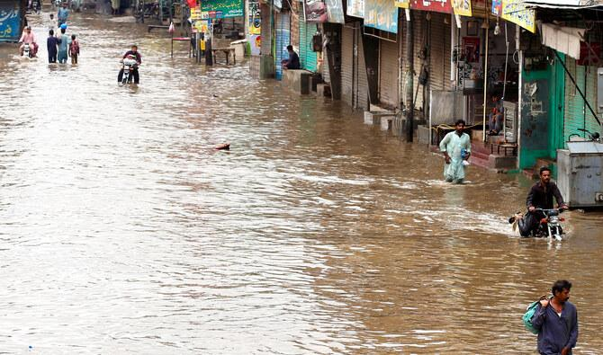

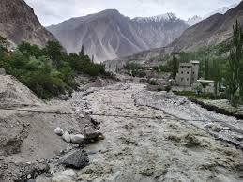


Performance Evaluation of NDMA Alerts 2025

Slide 2
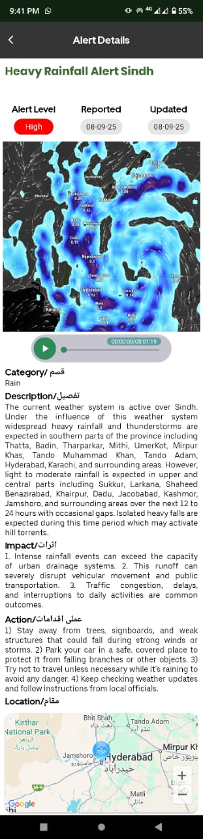
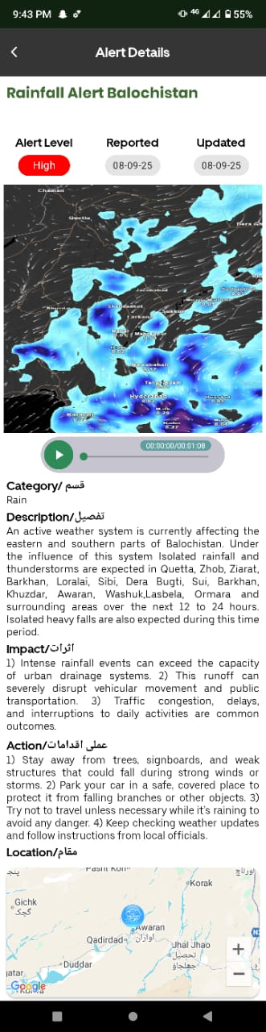
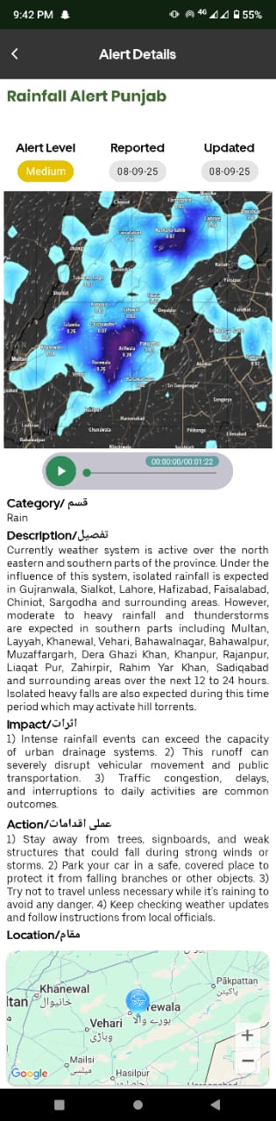
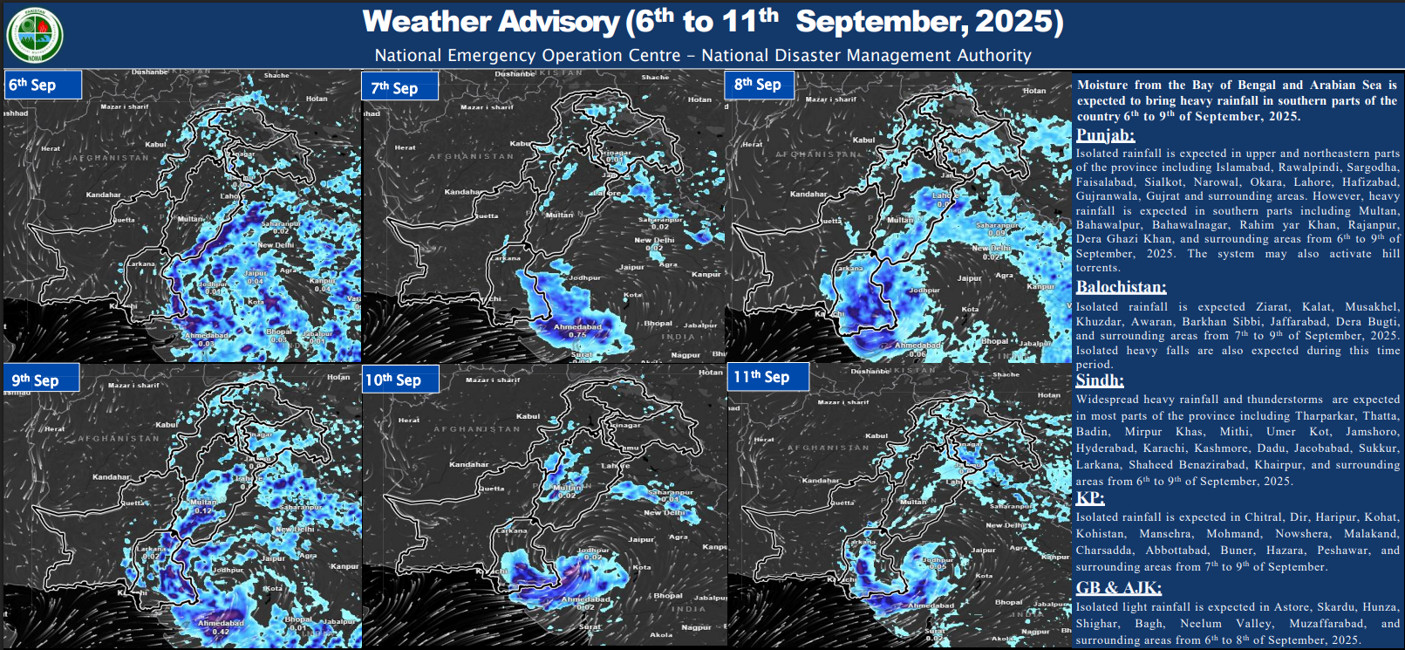

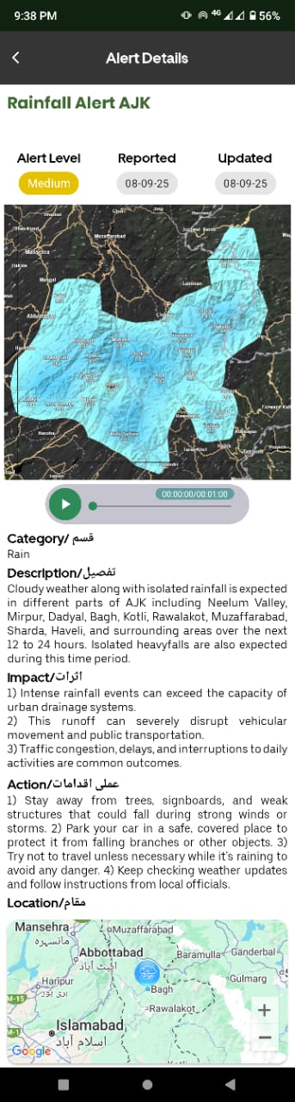
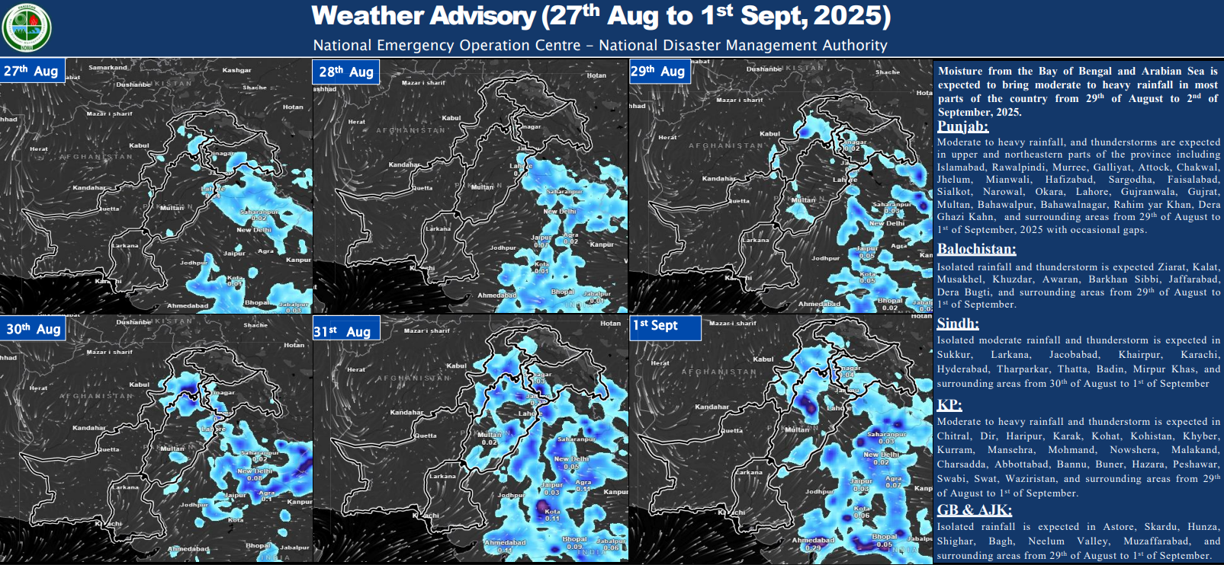
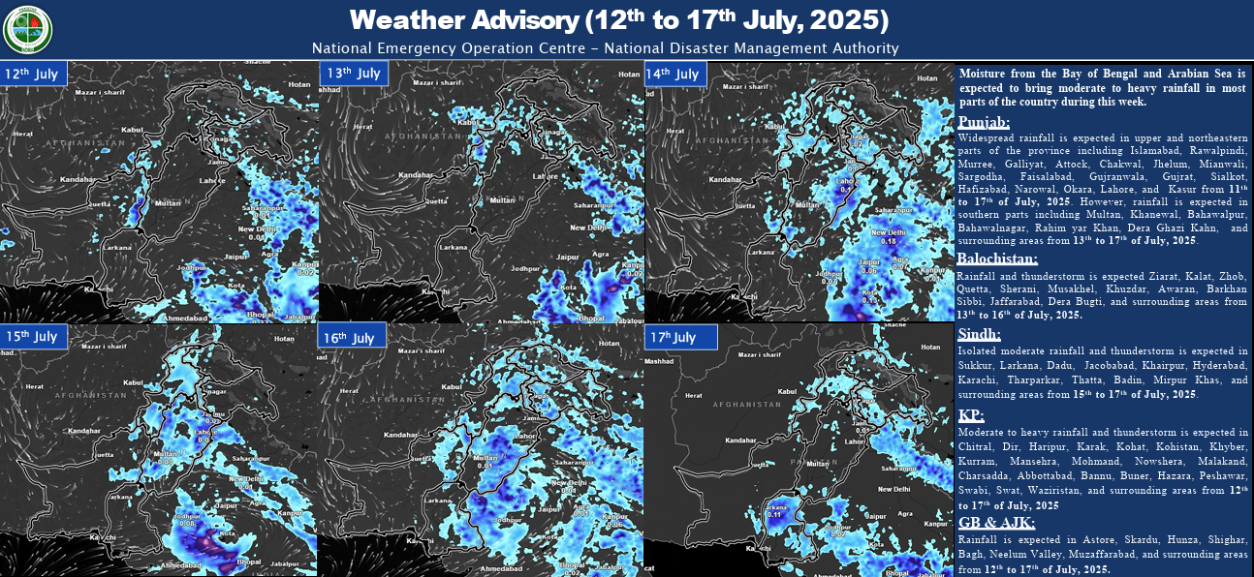
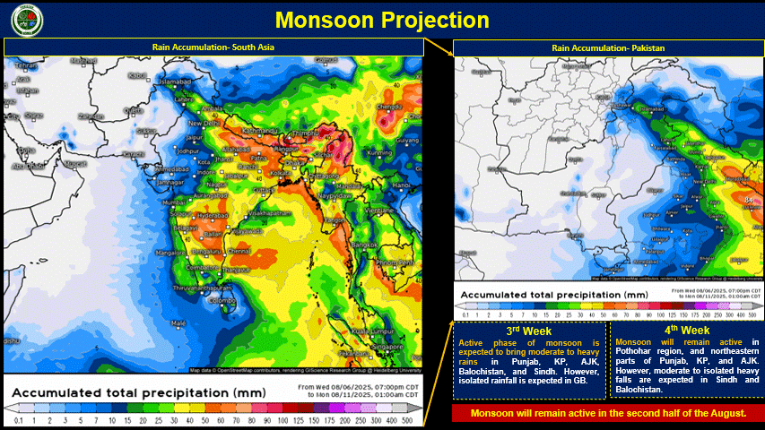
Data Collection

Slide 3





Algorithm Design.
Data Collector
Data Processor
Results
NLP Module
Encoding

Slide 4

Results and Discussion
Overall
87% $±$3%
140
Efficiency Calculated
Alerts Issued by Tech Team

Slide 5
Breakdown By Disaster Type During the Monsoon 2025

Slide 6
Thank You

